Slide 1
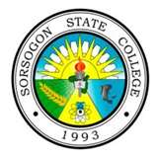
Sorsogon State College
Office of the Student Services
Contact Person: Prof. Teresita D. Aninipot
Director, Student Services
Office Telephone Number:052-421-55-24

